Slide 1
Hebrew Educational Society Center
Student’s Name
Instructor’s Name
Date

Slide 2
The Hebrew Educational Society. org
History- The Hebrew Educational Society. org was established in 1917. it was in the 20th century that philanthropists desired a change to how the Jewish people lived in new York. With the arrival of about 1.9 million Jewish people in the 1900s and pushed for an urgent need for the creation of a federation that would address the increasing demands (deFur, 2003). .
Size-the company serves around 1200-30,000 clients daily. There are more than 8500 people who participate in its programs. It is one of the largest facility in Southeast Brooklyn.
The major services program provides services offers ranges from recreational, sports, educational, mental health services, fitness programs, and OASAS preventive social services programs
The mission of the organization is to build a community, empower individuals to achieve their potential at the same time making their lives better.

Slide 3
The problem & why the service is needed
Hebrew Educational Society lacks a teen program that can better the teens life while participating in the program
Teens wish to get career development advice and mentorship
There is a need for a program that will benefit the teens such as employment program and mentoring program.
There is a high number of teens seeking for career development advice and mentorship program
The failure to address the issue threatens the reputation of the organization, creates a strained association between customers and the organization and also raises reliability concerns.

Slide 4
Client experience & what kind of clients we serve and why now we need to make the change
The current client experience is unsatisfactory because teens seeking mentorship as well as advice on how they would face life after school but are not able to get them.
The future of teens after high school is at stake because young people tend to involve themselves in risky behaviors such as joining gangs (Brager & Holloway,1993).
A career path & education would change their future for the better, so they can be prevented from going into gangs.

Slide 5
Specific change in the problem
The goal is to access to youth employment services and programs
Teens are seeking mentorship as well as advice on how they would face life after school (Homonoff, 2008).
There is a need to provide support services for the youths.

Slide 6
Table with the Goal 1& Goal 2 information
Goal #1 to implement job training career program | Goal #2 to implement a mentorship program at the center.
The objective is to ensure that most teens who leave high schools receive job training so that they can be equipped to become workers | The objective of this goal is to offer guidance to teen who complete high school so that they can choose career that they want
Action plan Present our incidences to the director as we experienced them with various IEP teens. | Action plan present the option to introduce a teen program through IEP transition planning to help teens figure out what they would like to be involved in after high school and how they will attain this goal. This will be best realized through an employment and mentoring program.

Slide 7
The methodology of the problem
We will send two representatives to the director to show him our minds.
This will hasten the process of a formal meeting with us as since he has always given volunteers a listening ear.
We will present our incidences as we experienced them with various IEP teens.
we will present the option to introduce a teen program through IEP transition planning to help teens figure out what they would like to be involved in after high school and how they will attain this goal (Friedman & Kornfeld, 2018).

Slide 8
Who is requesting for the program change and how can this change benefit the teens & family members
Parents & teens coming to the program are the ones asking for change
The change will help teens by providing mentorship and career development advice which will help the, in making important decisions in life.
Family members will be able to be relieved of the stress of mentoring and guiding their teens on these areas (Ingram, 2015).

Slide 9
The people involved in the teen program and their responsibilities
Director of Social Services- the social department director Mr. Gilbert Sunday will be the facilitating factor.
Job coach (2) role is to provide help and guidance for clients who are facing different professional challenges
Case Aid (2), will advise clients concerning suitable services
Job Placement Coordinator is responsible for keeping consistent communication with graduates and thoroughly tracking all employment activity
Career Coordinator brings together different elements or individuals to complete a project.

Slide 10
A Budget Chart
Budget categories | Total budget
Salaries for one clinical supervisor, job coach, mentor, and an aftercare case manager. | 150,000
All equipment | 20000
office space | 10000
Supplies -two computers, copy paper, printer, pens | 19700
Travel | 2300
Building refurbishment and maintenance | 10000
transportation funds for the teens to get to interviews or programs | 10000
trainings for staff | 5000
career events | 5000
Classroom supplies | 18000
Total budget | 250,000

Slide 11
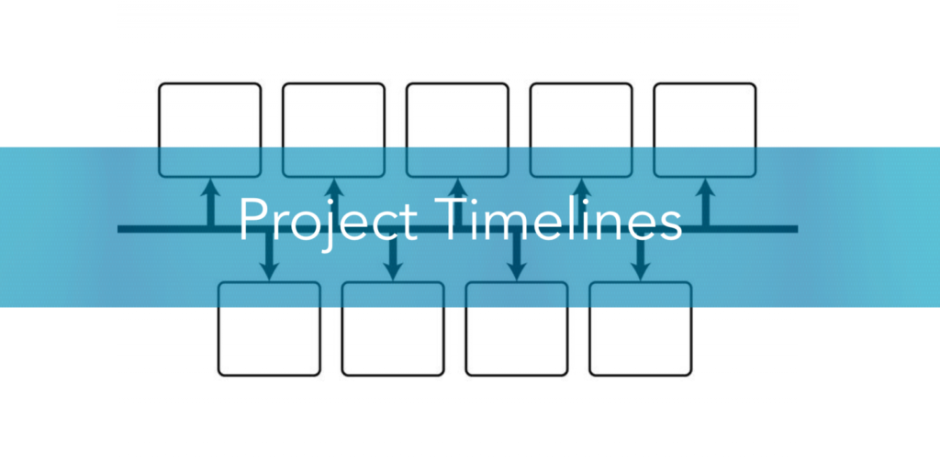
Timelines
The project is anticipated to begin immediately after its approval.
The first 2 months the organization will hire people, train and all the necessary resources and materials in order to enable the program to be undertaken.
The program is set to begin after 3 months of its approval when the organization will open its doors to its initial clients.
The teens who join the program will attend for a period of 2 weeks to receive career development guidance
The mentorship program will go on for a period of 6 months and above

Slide 12

Future funding
The organization will continue seeking for funding from various donors who have the passion to promote and develop teens
YouthBuild and other non profit organizations will be helpful in providing necessary funds for this project
The organization will also seek funding from government agencies responsible for the welfare of teens and youths
Funding sources are also likely to come from private sources, individuals and charitable organizations.

Slide 13

Sustainability
The teens career development and mentorship is a sustainable project because of the growing demand due to the large number of students completing high school.
the program will continue to be demanded as students come out of high school.
The undertaking of this project does not limit the organization from going on with other services that it offers
This project is therefore sustainable as it will still have an impact today and in the future.

Slide 14
About the Grant Funder
Youth Build is a competitive grant program that offer millions of money in annual funding
It is a non profit organization
YouthBuild specifically aids at-risk youth ages 16-24 that are recent or ex- high school dropouts
with the greatest challenges to finding good jobs.
Typical grant funding range-Approximately $89 million (2018) in annual funding
My proposal fits with what this organization stands for which is ensuring that teens who complete high school are taught important skills to allow them join the job market.

Slide 15
Grant Funder Contact Information
Division of Youth Services
Employment and Training Administration
U.S. Department of Labor
200 Constitution Ave NW
Room N-4508
Washington, DC 20210
202-693-3030
Fax: 202-693-3861
Email: youth.services@dol.gov

Slide 16
My Role As A Social Worker Intern
I believe my role involves strengthening the community, empowering individuals and making a positive impact
The data be measured for the new program by carrying out a survey on the youths who will have gone through the mentorship and career development program
This survey will measure whether the interventions were effective in changing their lives
The step by step process I will take to develop the program is first to ensure that it is approved. The second step involves finding the right environment and qualified instructors and mentors to teach and mentor the teens.
The program must have its goals and objectives to guide learners and educators. Enrollment of students to be done afterwards and changes made according to the need of students

Slide 17
References
Brager, G., & Holloway, S. (1993). Assessing prospects for organizational change: The uses of force field analysis. Administration in Social Work, 16(3-4), 15-28.
deFur, S. H. (2003). IEP transition planning-from compliance to quality. Exceptionality, 11(2), 115-128.
Friedman, J. B., & Kornfeld, M. (2018). Identity Projects: Philanthropy, Neoliberalism, and Jewish Cultural Production. American Jewish History, 102(4), 537-561.
Homonoff, E. (2008). The heart of social work: Best practitioners rise to challenges in field instruction. The Clinical Supervisor, 27(2), 135-169.
Ingram, R. (2015). Understanding emotions in social work: Theory, practice and reflection. McGraw Hill.

